Slide 1
Database and file Concepts

Slide 2
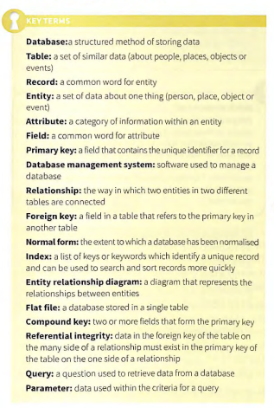
KEY Notes

Slide 3
Relationships within a database
The three relationships Relationships within a database can be used to connect entities together . A foreign key is an attribute (field) in one entity that connects to a primary key in another entity. This allows related data to be looked up and found.

Slide 4
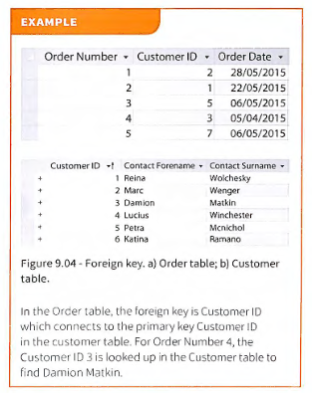
Relationship

Slide 5
Relationship
One-to-one A one-to-one relationship is when each record in one table only connects to one record in another table. Each foreign key value will link to one primary key value and each primary key value will only be linked to by one foreign key value. The foreign key can exist on either side of the relation ship.

Slide 6
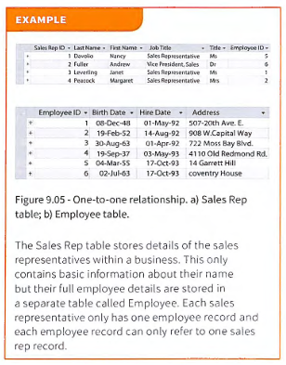
One to One

Slide 7
One to many
One-to-many A one- to-m any relationship is w hen each record in one table can connect to man y (zero or more ) records in another table . A foreign key will exist within the table on the many side of the relationship and will connect to a primary key in the one side of the relations hi p. This is the most common type of relationship within relational databases.

Slide 8
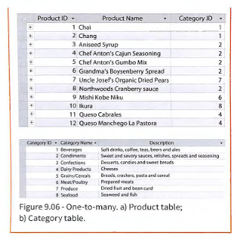
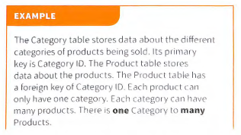
One to many

Slide 9
Many to Many
Many-to-many Many-to-m any relationships are only conceptual. They are not used in relational databases because they are converted into two sets of one-to-many relationships. In a many-to- many relationship, each record in one tab le can connect to many records in another table but each record in the other table can also connect to many records in the original table

Slide 10
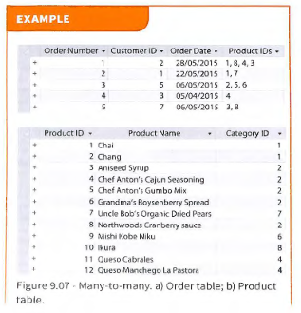
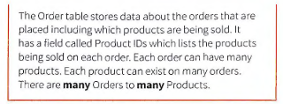
Many to many

Slide 11
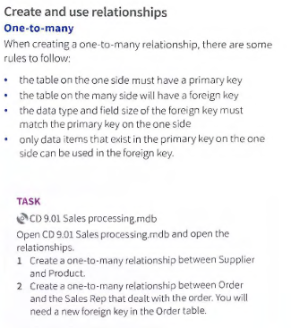
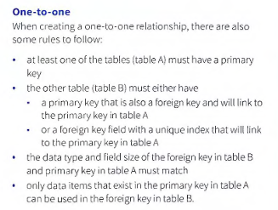
Create and use relationship

Slide 12
Entity Relationship Diagram(ERD)
Create and interpret an entity relationship diagram An entity relationship diagram (ERD) shows the relationships (connections) between each entity. Each entity is represented by a rectangle. Each relationship is represented by a line.

Slide 13
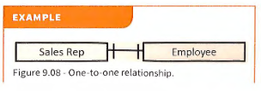
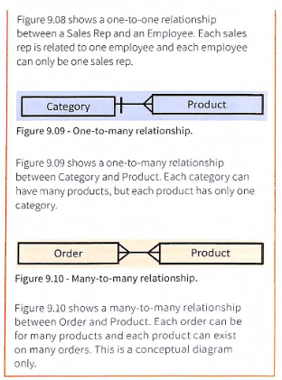

Slide 14
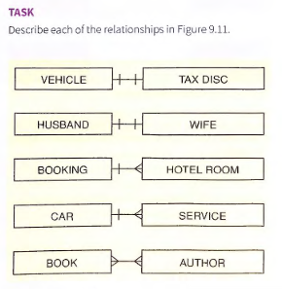

Slide 15
Many to many
An ERO will usually have more than just two tab les. The ERO in Figure 9.14 shows the relationships that exist within a bank. Each branch of the bank can have many customers. Each customer can have many accounts. Each account can have many transactions taking place . Each account can be of only one type bul each type of account can exist as many accounts. When a many-to-many relationship exists, it is necessary to break it dow n into two one-to-many relatio nships. The general rule for this is to put a LINK table between the two entities as shown in Figure 9.16.

Slide 16
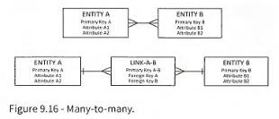
Many to many

Slide 17
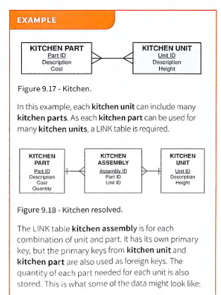
Many to Many

Slide 18
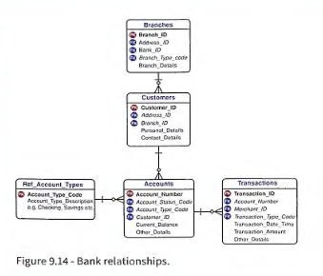
Many to many

Slide 19
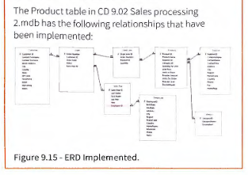

Slide 20
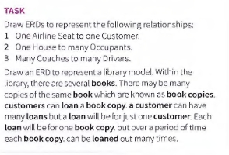

Slide 21
form
In Microsoft Access, a form is a user interface object that allows users to interact with and manipulate data stored in tables or queries, providing a more user-friendly way to view, enter, and edit information compared to directly working with the tables themselves.

Slide 22
form
Purpose:
Forms serve as a visual interface for interacting with your database, making it easier for users to add, modify, and view data.
Data Interaction:
Forms can be "bound" to a table or query, meaning they display and allow interaction with the data stored in that source.
User Experience:
Forms can be customized to present data in a specific way, such as displaying only certain fields or organizing data in a particular layout.
Controls:
Forms can contain various controls (like text boxes, buttons, list boxes, etc.) to facilitate data entry and navigation.

Slide 23
Data Entry:
Forms can streamline data entry by providing a structured and intuitive interface, reducing errors and improving efficiency.
Data Display:
Forms allow users to view data in a more organized and readable format than a raw table.
Automation:
Forms can also include features like command buttons and other functionalities to automate frequently performed actions.
Access Control:
Forms can be designed to restrict access to certain fields or operations, enhancing data security and integrity.
Examples:
Imagine a customer database where you want to create a form to easily add new customer information, or a form to view and edit order details, or a form to display product information.

